Slide 1
Wire Fraud, Cybersecurity and what it means for your settlement transactions
Presented by
Nori Strong, VP, National Escrow Director
Shabnam Jalakian, VP, Chief Information Security Officer

Slide 2
Wire Fraud Nori Strong VP, National Escrow Director
©2015 First American Financial Corporation and/or its affiliates. All rights reserved. q NYSE: FAF

Slide 3
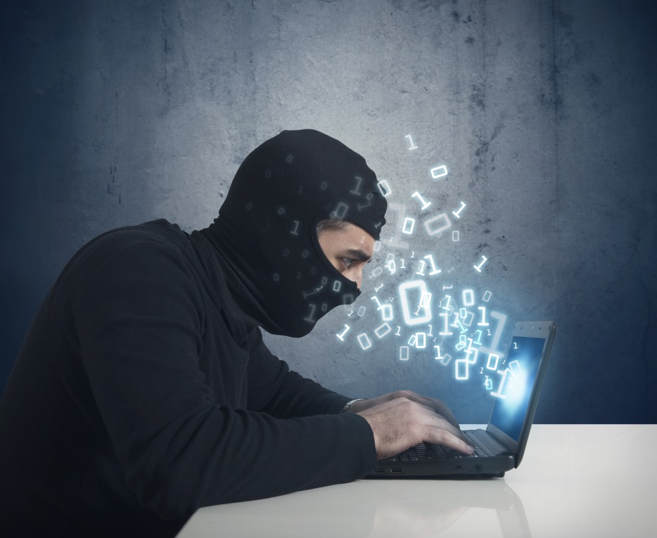
Wire Fraud
What is wire fraud as defined by the Financial Crimes Enforcement Network (FinCEN)?

Slide 4
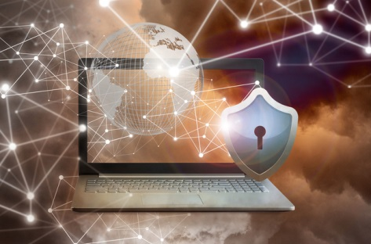
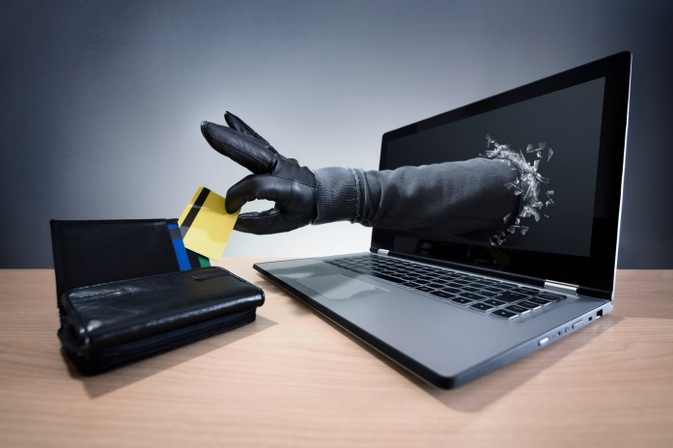
Different Types of Wire Fraud
Business E-Mail Compromise, or (BEC) targets financial institutions and their customers
E-Mail Account Compromise, or (EAC) targets a victim’s personal account

Slide 5
Actual Breaches
Example 1: In a construction loan draw request, the general contractor’s email account was breached and wire instructions for the draw request were intercepted and changed to a fraudulent account. A fraudulent email was sent to the developer, who in turn sent it to the settlement officer with instructions to proceed with disbursement.
Example 2: One of 45 disbursements on a transaction involved payment of an invoice sent to the buyer; buyer in turn sent it to their attorney who sent it to the settlement officer with instructions to pay at close of escrow. As it turned out, the buyer’s email account was breached by a fraudster and the money was sent to the fraudster’s account.
Example 3:Buyer’s email account was breached and wire instructions for earnest money deposit were rerouted to a fraudster’s account.

Slide 6
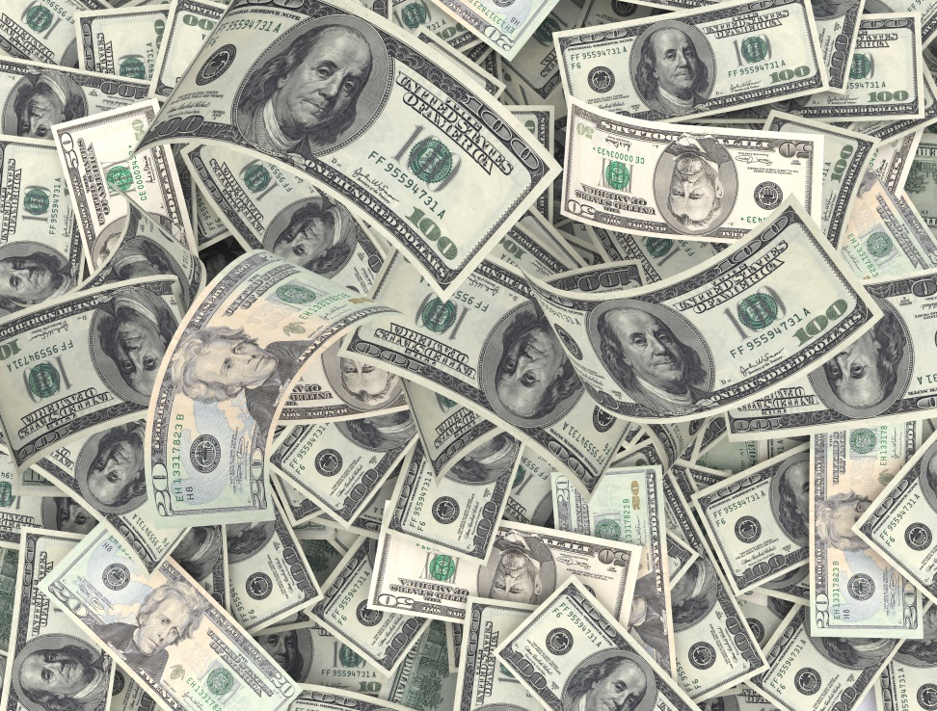
According to FinCEN
From 2013 through September 6, 2016, there have been approximately 22,000 reported cases of email compromise fraud, involving $3.1 billion.

Slide 7
Red Flags/ Warning Signs
Change in Wire Instructions
Resembling a customer’s email account
Foreign Bank
Emailed instructions marked as “immediate”, “urgent”, “high importance” or “secret”
Wording that is grammatically incorrect, misspelled names, or changed bank accounts
Changing method of payment

Slide 8
Latest Schemes
Phone Spoofing
Can you hear me?
Latest twist on wire fraud

Slide 9
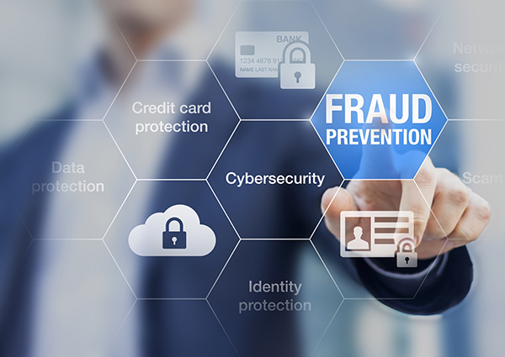
How do we combat wire fraud?
Awareness is KEY!

Slide 10
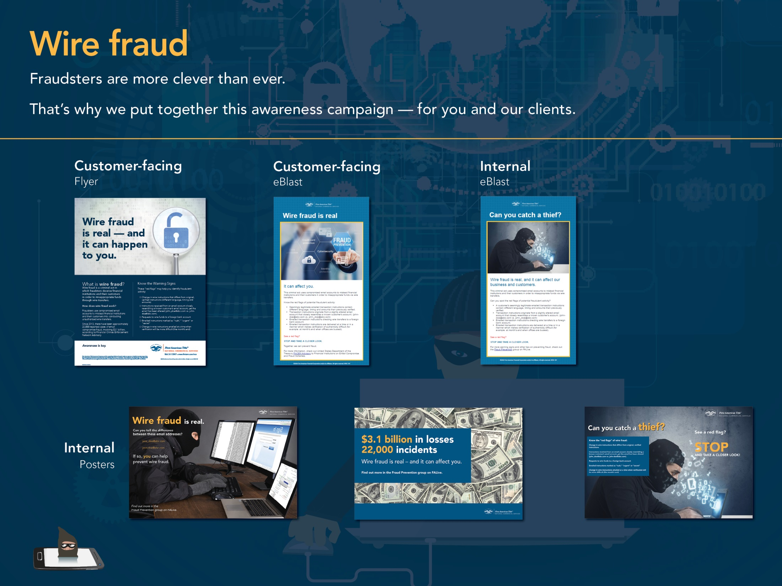
Marketing Materials

Slide 11
Cyber Fraud Detection and Prevention Shabnam Jalakian Vice President, Chief Information Security Officer

Slide 12
Agenda
Current Trends In Security
Cyber Fraud Fundamentals
How did we get here?
Cyber attack techniques
Specifics on Techniques & Practical Tips
Social Engineering
Phishing
Social Media
Malware & Viruses
Wire Fraud
Tales From the Internet

Slide 13
Current Trends In Security
Proliferation of NPI/NPPI – Multiple recent breaches of public/private companies & government entities
Client data loss- Transaction details, bank account information, wire instructions, trades, client lists, etc.
Increase in wire transfer fraud cases– changing wire transfer numbers to steal money
Insider threat - Corporate espionage, violation of least privilege access model
Loss of company confidential/ Intellectual property - proprietary research, models, points of view, trading patterns, and strategies
Reputation damage – loss of consumer confidence and brand erosion
Increased Regulatory Scrutiny

Slide 14
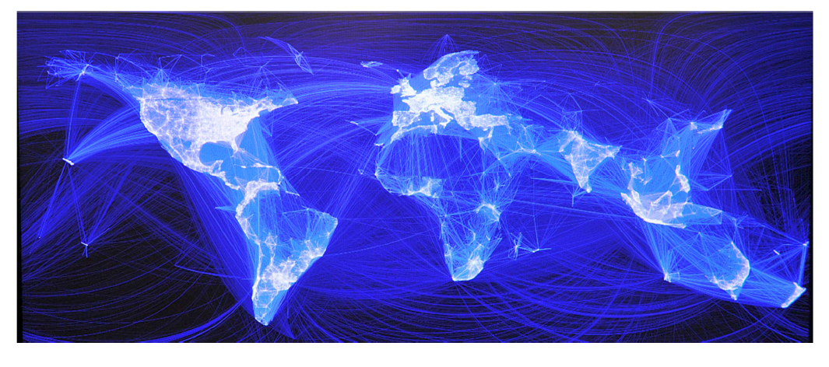
Cyber Fraud
Using modern techniques to commit fraud
Brave, New, Interconnected world accessible from a computer
Notes:
Using modern techniques to commit fraud

Slide 15
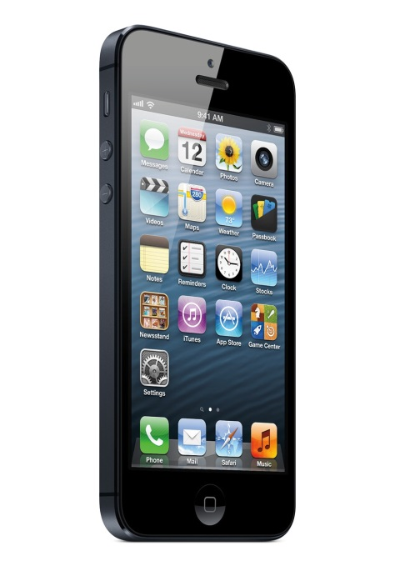
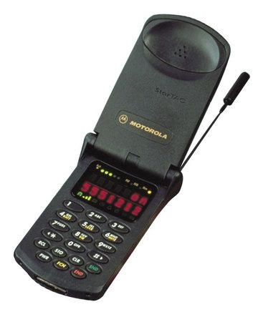
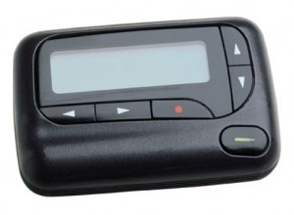
Cyber Game Changer
Notes:
We all carry computers with us everywhere = our smartphones

Slide 16
Cyber Game Changer
Technology has touched and fundamentally changed virtually all aspects of our lives
How we do business
Shop
Bank
Communicate
Socialize
Recreate
Some of these shifts have been sudden and dramatic, while others have been more subtle
Notes:
Changed

Slide 17
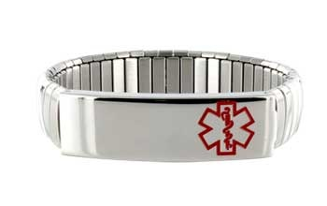
Cyber Era Priority Shift

Slide 18
Cyber Era Priority Shift
DELETE MY BROWSER HISTORY

Slide 19
Cyber Era Impact on Fraud
Global connectivity
As of Today, 3.2 billion people or almost ½ of the world’s total population, has access to the Internet
60% of Internet users are in developing countries
Today, there are over 2 billion computers connected to the Internet.
By 2020, the number networked devices or the “Internet of Things” will outnumber people by six to one
Notes:
We are super connected
About ½ of the world’s population
Soon, networked devices will outnumber people by 6 to 1

Slide 20
Targets of Cyber Fraud
Notes:
It’s important to realize that you are in fact a taret

Slide 21
Cyber Attacker Techniques
Hacking
Manual or Automated
Takes advantages of weaknesses in systems
Social engineering
Takes advantage of human weaknesses
Malware or Viruses
Physical access

Slide 22
Cyber Fraud Techniques
The most damaging compromise tends to be our personal or work e-mail credentials.
With these credentials, cyber criminals can gain control of our bank accounts, see what we’re working on, etc. and then interject themselves at an opportune moment.
Notes:
The biggest threat is e-mail accounts being compromised

Slide 23
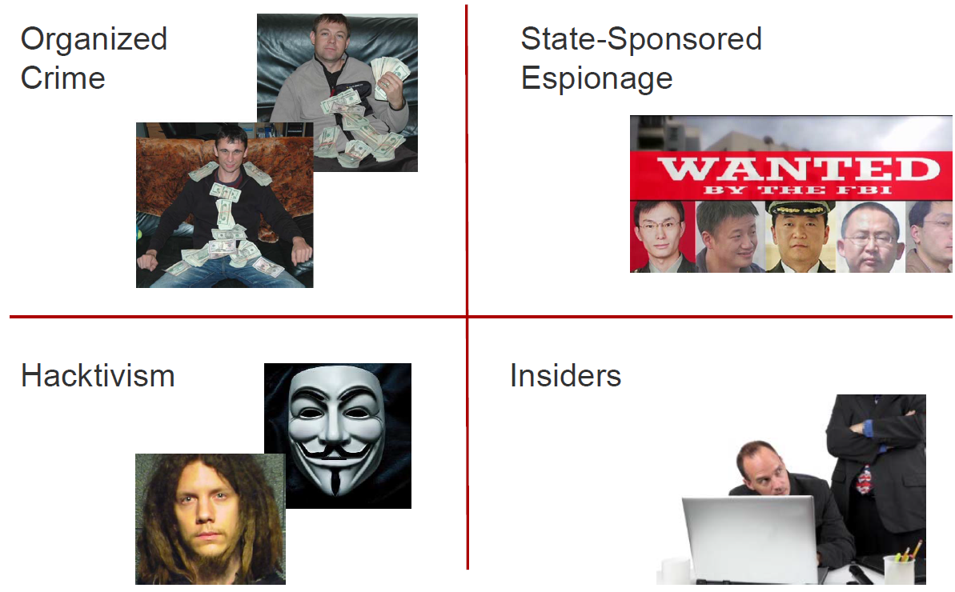
Cyber Attackers
Notes:
Script Kiddies
Competitors
(H)Activists
Organized Crime
Employees
Governments
Any one of these can be on the inside of your organization

Slide 24
Cyber Attackers
The capabilities of cyber attackers vary depending upon skill and resources
However, keep in mind that sophisticated hacking tools that automate breaking into computer networks and systems are available for sale or download over the Internet
Motivations vary as well but fall into three general categories:
Personal politics
Financial gain
National interests
Notes:
Some hackers are better than others
All can get hacking tools and instructions on the Internet

Slide 25
Social Engineering

Slide 26
Social Engineering
Social engineering is a type of psychological attack where an attacker misleads you into doing something they want you to do.
Cyber attackers use this technique on the Internet because it is extremely effective and can be used to target millions of people.

Slide 27
Social Engineering
FedEx/UPS sends you or your employees an e-mail saying that they need to re-validate their account info or the account will be suspended – please log in here
FedEx/UPS sends your or your employees an e-mail saying that invoices are attached – please click here

Slide 28
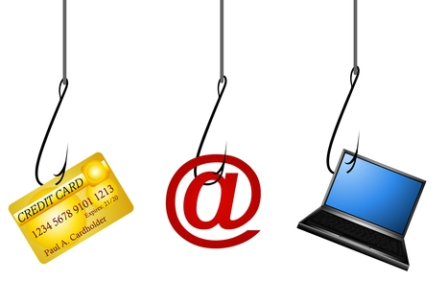
Phishing
Notes:
Today’s topic – Phishing and Other Threats. And how NOT to get hooked. It’s important not only to First American but also to you personally.

Slide 29
Phishing
Phishing refers to an attack that uses email or a messaging service (like those on social media sites) that tricks or fools you into taking an action, such as clicking on a link or opening an attachment.
Phishing often involves a combination of solid marketing and effective social engineering
Spear-Phishing is a specifically targeted form of phishing
Whaling
CEO Fraud

Slide 30
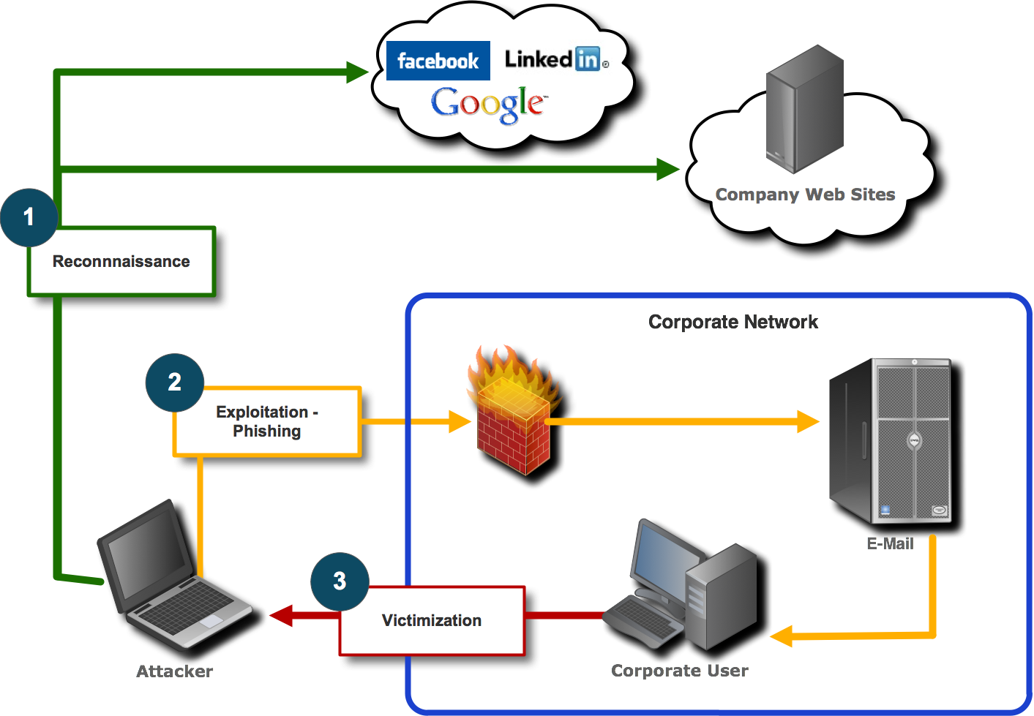
Phishing
The New Path into the Company

Slide 31
Phishing
Generic greeting
Forged link
Requests personal information or includes an attachment to view
Sense of urgency
Bad grammar
Notes:
Generic greeting. Phishing emails are usually sent in large batches. To save time, Internet criminals use generic names like "First Generic Bank Customer" so they don't have to type all recipients' names out and send emails one-by-one. If you don't see your name, be suspicious.
Forged link. Even if a link has a name you recognize somewhere in it, it doesn't mean it links to the real organization. Roll your mouse over the link and see if it matches what appears in the email. If there is a discrepency, don't click on the link. Also, websites where it is safe to enter personal information begin with "https" — the "s" stands for secure. If you don't see "https" do not proceed.
Requests personal information. The point of sending phishing email is to trick you into providing your personal information. If you receive an email requesting your personal information, it is probably a phishing attempt.
Sense of urgency. Internet criminals want you to provide your personal information now. They do this by making you think something has happened that requires you to act fast. The faster they get your information, the faster they can move on to another victim.

Slide 32
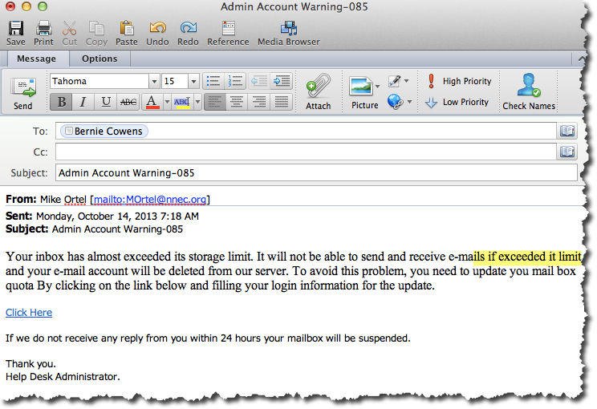
Phishing

Slide 33
Phishing
"We suspect an unauthorized transaction on your account. To ensure that your account is not compromised, please click the link below and confirm your identity.“
"During our regular verification of accounts, we couldn't verify your information. Please click here to update and verify your information. Failure to act immediately…"
“Our records indicate that your account was overcharged. You must call us within 7 days to receive your refund.”

Slide 34
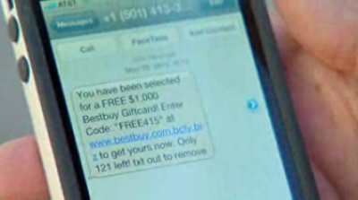
SMSishing
Same problem - different device

Slide 35
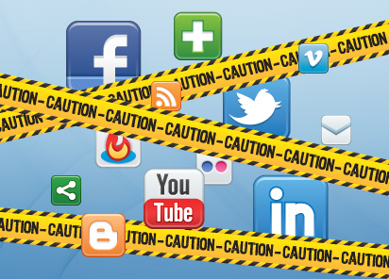
Social Media

Slide 36
Social Media
Cyber attackers can analyze your posts and use them to gain access to your or your organization’s information.
For example, they can use information you share
Guess the answers to the secret questions that reset your online passwords
Create targeted email attacks against you (called spearfishing) or call someone in your organization pretending to be you
In addition, these attacks can spill into the physical world, such as identifying where you work or live

Slide 37
What You Can Do Social Media
Keep your business and personal life separate
Do not accept invitation from people you don’t know
Do not click on any URL links
Be aware of URL shorteners
Do not download attachments

Slide 38
What You Can Do Social Media
Protect your social media accounts and online activities:
Limit your posts
Login controls
Privacy Settings
Encryption:
Email
Malicious Links/Scams
Mobile Apps
Notes:
Protect your social media accounts and online activities:
Login: Protect each of your accounts with a strong, unique password and do not share them with anyone else. In addition, many social media sites support stronger authentication, such as two-step verification. Always enable these stronger authentication methods whenever possible. Finally, do not use your social media account to log in to other sites; if it gets hacked, then all of your accounts are vulnerable.
Privacy Settings: If you do use privacy settings, make sure you review and test them regularly. Social media sites often change privacy settings and it is easy to make a mistake. In addition, many apps and services let you tag your location to content that you post (called geotagging). Regularly check these settings if you wish to keep your physical location private.
Encryption: Social media sites use encryption called HTTPS to secure your online connections to the site. Some sites (like Twitter and Google+) enable this by default, while others require you to manually enable HTTPS. Check your social media account settings and enable HTTPS as the default connection whenever possible.
Email: Be suspicious of emails that claim to come from social media sites. These can easily be spoofed attacks sent by cyber criminals. The safest way to reply to such messages is to log in to your social media website directly, perhaps from a saved bookmark, and then read and reply to any messages or notifications from the website.
Malicious Links/Scams: Be cautious of suspicious links or potential scams posted on social media sites. Bad guys use social media to spread their own attacks. Just because a message is posted by a friend does not mean that message is really from them; their account may have been compromised. If a family member or friend has posted an odd message you cannot verify (i.e., they have been robbed and need you to send money), call them on their mobile phone or contact them by some other means to confirm the message is truly from them.
Mobile Apps: Most social media sites provide mobile apps to access your online accounts. Make sure you download these mobile apps from a trusted site and that your smartphone is protected with a strong password. If your smartphone is unlocked when you lose it, anyone can access your social media sites through your smartphone and start posting as you.

Slide 39
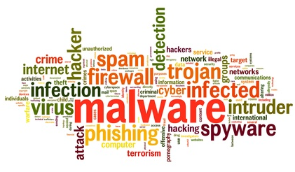
Malware / Viruses
Simply put, malware is software -- a computer program -- used to used to perform malicious actions
Goal is to make money from your infected computer or device, perhaps by selling the data they’ve stolen from you, sending spam emails, launching denial of service attacks, or performing extortion.

Slide 40
Malware / Viruses
Types of programs used by criminals to infect computers and devices.
Virus
Trojan
Ransomware
Rootkit

Slide 41
Malware / Viruses
Ransomware is a special type of malware that is actively spreading across the Internet today, threatening to destroy victim’s documents and other files.
Encrypts certain files or your entire hard drive.
The most common method comes in via an infected attachment or link vis phishing e-mails
To pay or not to pay?
Perhaps the best way to recover from a ransomware infection and not pay a ransom is to recover your files from backups.
DON’T CLICK LINKS!

Slide 42
What You Can Do Malware / Viruses
Install anti-virus software from trusted vendors.
Anti-virus cannot block or remove all malicious programs.
Make sure your operating systems, applications, and devices are enabled to automatically install updates.
Only download and install apps from trusted online stores.
Only install mobile apps that have been posted online for a long time, downloaded by a large number of people, and have numerous positive reviews.

Slide 43
What You Can Do Ransomware
Keep your computer fully patched
Keep anti-virus / anti-malware running and current
Don’t click on links you don’t know
Don’t download attachments you don’t recognize
Backup all data (3-2-1)

Slide 44
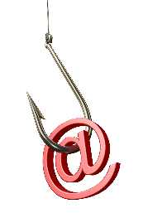
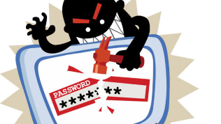
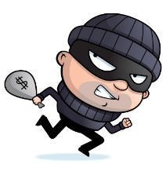
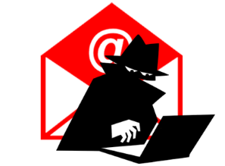
Wire Fraud
Agent, broker, seller or buyer receives phishing email
Adversary compromises user email account
Adversary monitors and reads all user emails
Original
Bank
New
Bank
Money moved to adversary bank account and shortly thereafter to another account(s)
Banks and accounts are substituted for a “mule” account
Last minute, adversary modifies wiring instructions

Slide 45
What You Can Do Wire Fraud
Protect your email and password
Verify email headers
Call the other party to confirm
Check your email for signs of compromise
Add multifactor authentication

Slide 46
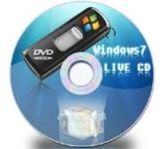
What You Can Do Banking and Trust Accounts
The Financial Services Information Sharing and Analysis Center (FS-ISAC) – issued guidelines urging businesses to carry out all online banking activities from "a stand-alone, hardened and completely locked down computer system from where regular e-mail and Web browsing is not possible.”
Their recommendations include:
Multi-factor authentication
Stand alone dedicated PC not running Windows™
An Apple MAC
A Linux PC
Live CD*

Slide 47
What You Can Do Banking and Trust Accounts
International wire blocks – some banks are offering this service
ACH blocks
Positive pay
Dedicated stand alone computer

Slide 48
Mobile Devices
Mobile Devices Know Too Much!
Text messages – whether deleted or not
Thousands of locations you (or at least your phone) has been – access to towers logged
Every web site you’ve ever visited
Words in your personal dictionary (passwords?)
The locations you’ve mapped
Your Facebook posts and contacts
Photos with geo-location data attached - Web photos that reveal secrets, like where you live

Slide 49
What You Can Do Mobile Devices
Encryption - most devices offer the ability to scramble the information on the device so that it cannot be recovered if you lose the device
Strategy: Turn it on
Encryption is useless if you don’t password or PIN protect the device before you lose it.
Strategy: Set a strong PIN or password
Strategy: Change your PIN / Password periodically
Consider find my device / wipe technologies

Slide 50
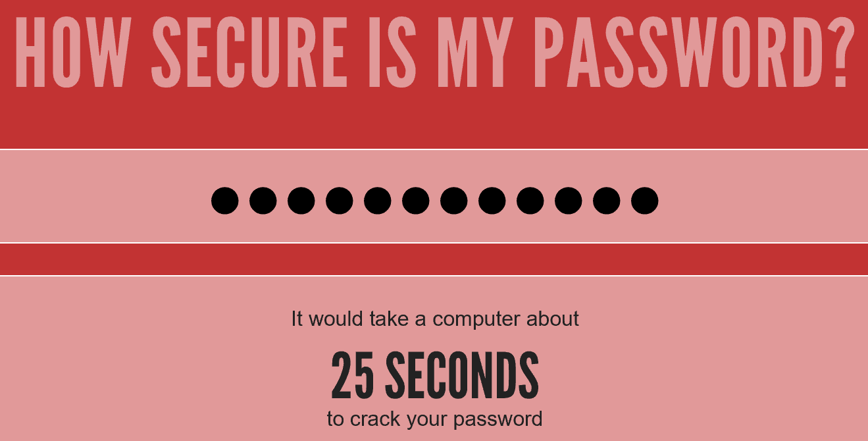
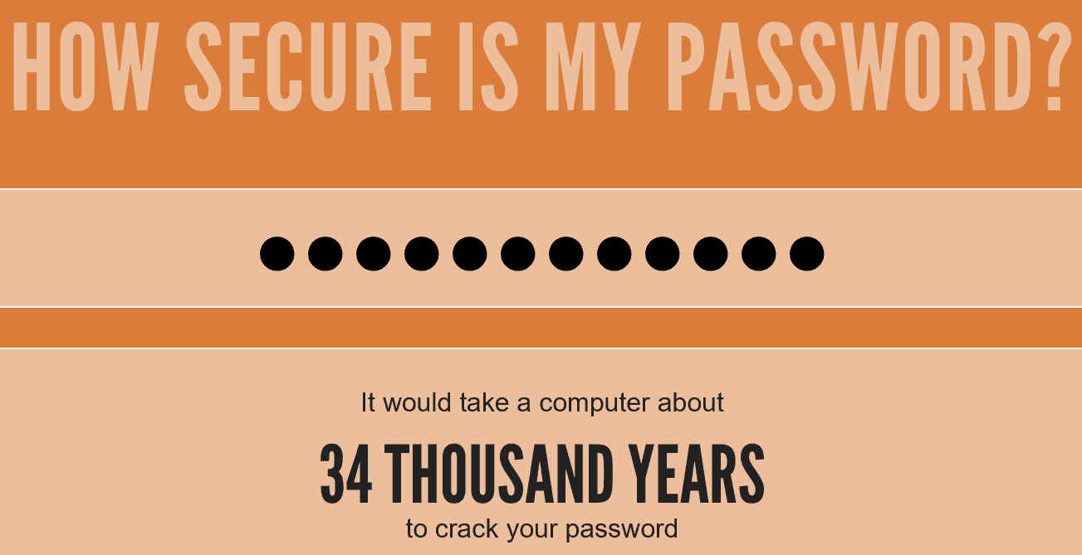
Passwords
We use passwords every day, from accessing your email and banking online to purchasing goods or accessing your smartphone.
Passwords are also one of our weakest points
Weak password Scheme Strong password Scheme

Slide 51
What You Can Do Passwords
Don’t use the same password for Facebook, LinkedIn, your office and your bank?
Strong passwords are essential to protecting yourself.
Consider using password safes
Avoid sharing passwords
Develop a strong password scheme/Passphrase
https://howsecureismypassword.net/

Slide 52
Encryption
When information is not encrypted, it is called plain text.
Anyone can easily read or access it.
Encryption converts information into a non-readable format called cipher text.
Encryption works by using complex mathematical operations and a unique key to convert your information into cipher text.

Slide 53
Encryption
Data at rest
Information you store on your systems
Use Full Disk Encryption
Enable encryption on mobile devices
Data in motion
Use e-mail encryption solutions
Consider using TLS, wherever available
Removable media
Use encrypted thumb drives

Slide 54
Awareness is Key!
Their techniques are often innovative and evolve as we develop awareness and countermeasures
“To use a castle wall metaphor … we’ve gone from 10 foot walls to 12 foot walls, but some of the bad guys now have 14 foot ladders.”
Awareness of their techniques is key to protecting yourself and your business
Notes:
Awareness of modes of attack and techniques is key

Slide 55
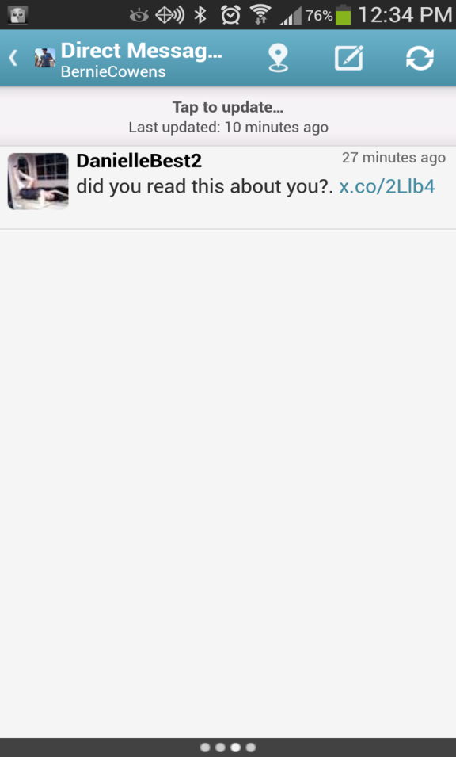
Tales from the Internet

Slide 56
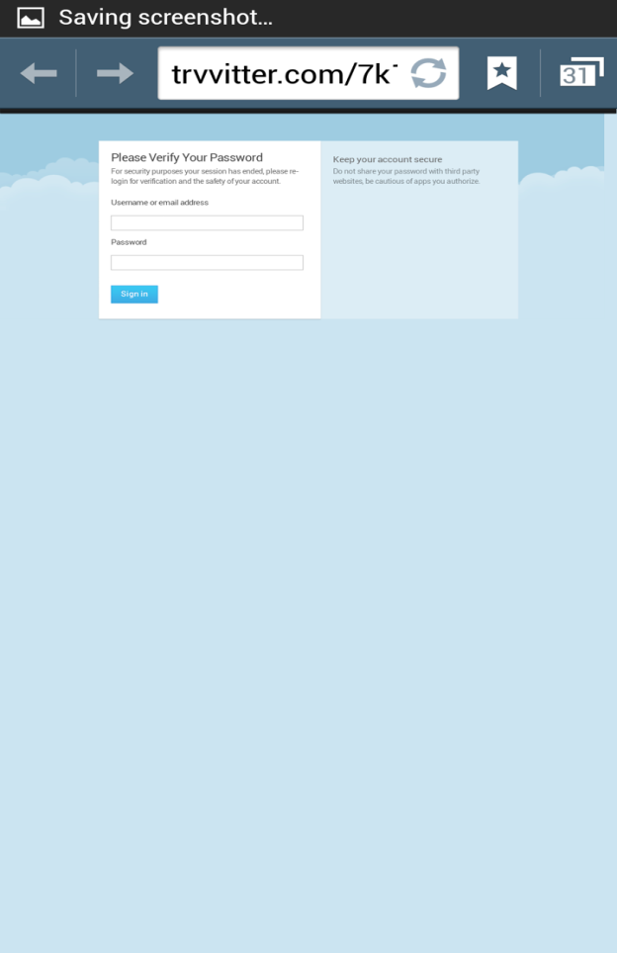
Tales from the Internet

Slide 57
Tales from the Internet

Slide 58
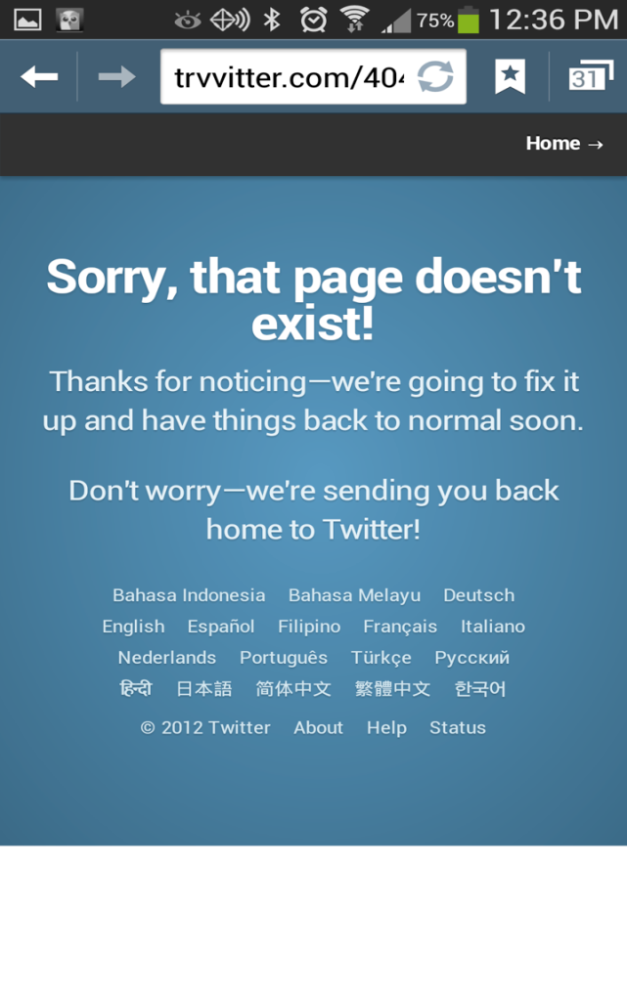
Tales from the Internet

Slide 59
Tales from the Internet
Okay, so now they have my “Twitter” account credentials.
Unfortunately, most of us tend to use the same or similar password across systems (banking, e-mail, work accounts).
Gaining access to one account, when combined with all of the publicly-shared personal information available via social networking sites quickly leads to a compromise of other accounts.
Notes:
What might be a crime in the U.S., might not be in another country.

Slide 60
Tales from the Internet
An employee in your company walks into the office one morning and finds a USB stick on the floor near their desk.
The USB stick is labeled, “Executive Compensation”
The employee inserts the USB stick into their computer and opens a file stored on the device
The file appears to be unreadable

Slide 61
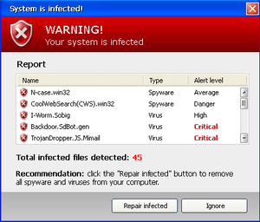
Tales from the Internet
While browsing the Web, you get a pop-up window that appears to show an anti-virus scan in progress. Subsequently, a warning appears informing you that your machine is infected.
Your choice:
“Repair Infected”
“Ignore”

Slide 62
Tales from the Internet
Suddenly, you get a popup window that says your personal files have been encrypted
Notes:
Time is of the essence. Yes, they really will unencrypt your files. If they didn’t, others wouldn’t pay. They accept payment only by BitCoin and by MoneyPak

Slide 63
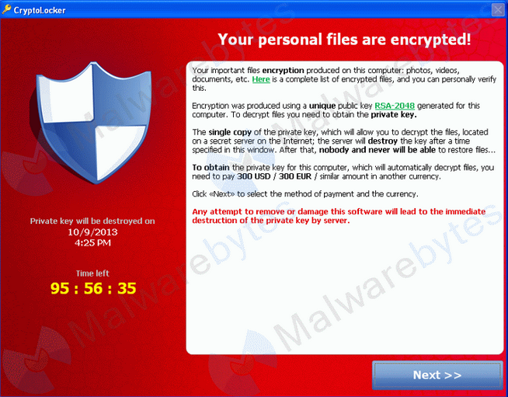
Tales from the Internet
Suddenly, you get a popup window that says your personal files have been encrypted
Notes:
Time is of the essence. Yes, they really will unencrypt your files. If they didn’t, others wouldn’t pay. They accept payment only by BitCoin and by MoneyPak

Slide 64
Tales from the Internet
A warning pops up on your screen informing you that the FBI has detected that your PC has been used for criminal acts (downloading illicit images, pirated music, movies, etc.).
Your computer is frozen and you cannot get off of the screen
If you don’t immediately pay a fine (instructions for doing so included), the FBI will arrest you.

Slide 65
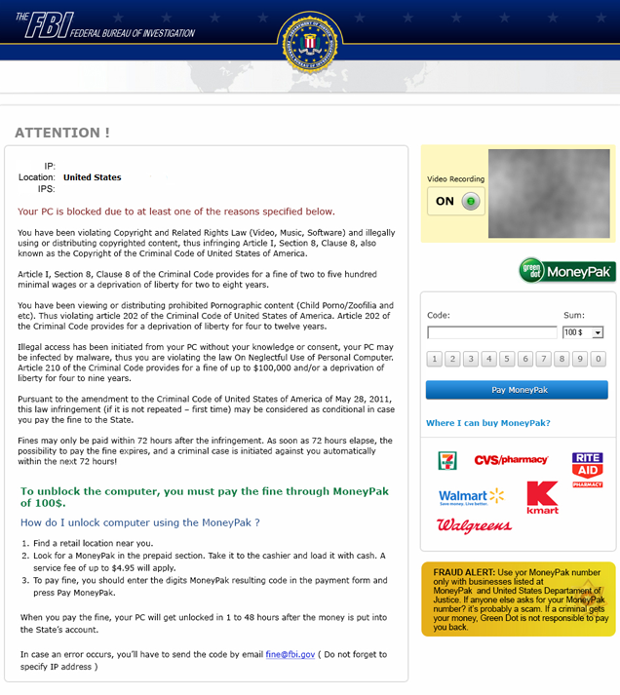
If it came to you from the Internet
By the way … we’re watching you
Multi-use form – pick your crime
Convenient – Head on over to Walmart or RiteAid to pick up a MoneyPak!
Urgent – only 72 hours to make this little problem go away!
Fake AV
Variation on the FBI thing
Pop up from drive by malware (Reveton)

Slide 66
Questions

Slide 67
Wire Fraud, Cybersecurity and what it means for your settlement transactions
Presented by
Nori Strong, VP, National Escrow Director
Shabnam Jalakian, VP, Chief Information Security Officer

